Slide 1

Rentitus
Team - T21

Slide 2
What is Rentitus?(project description)
What is our purpose?
How this web application help users?
What is the business opportunity?

Slide 3
What is Rentitus?(project description)
What is our purpose?
How this web application help users?
What is the business opportunity?

Slide 4
Team Members & Roles
UI Designer | Abdelaziz Omar
Full Stack Developer | Artem Elagin
Data Manager | Elham Veisouei
Testing Engineer; Scrum Master | Lale Mulati

Slide 5

Detailed Demo of Project as developed till date
Project Management Tracker
Milestones
Upcoming

Slide 6
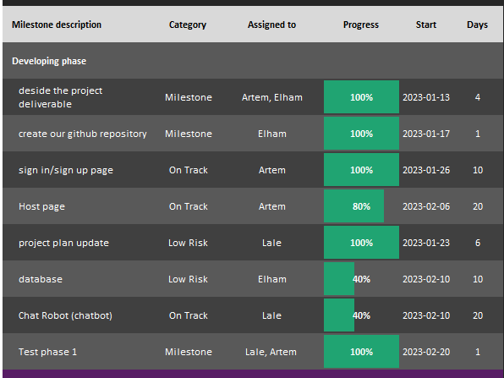
Milestone
From the beginning of this semester (Jan 13, 2023) till now, during total 39 days, as you can see, these are the tasks we done and some of them still going on.

Slide 7
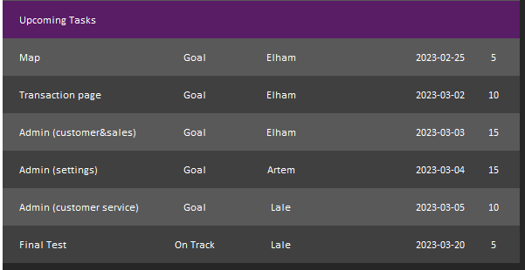
These are the tasks we have planned for the upcoming milestone, but we believe there is much more to do in addition to these tasks.

Slide 8

Project Description
Git Repository

Slide 9
What is Rentitus?(project description)
What is our purpose?
How this web application help users?
What is the business opportunity?

Slide 10
SCOPE
In Scope
Out of Scope
Sign in
Sign up
Become a host
Content description
Customer review
Insurance
Category
Filter
Checkout
Map
Due Date Alarm
Live chat
FAQ
Financial Calculator
newsletter subscriptions
Employee bios (biography)
Blog

Slide 11
Project Description
Git Repository
Notes:
https://duotone.shapefactory.co/?i=phIFdC6lA4E&f=3fc7ff&t=2c0058&q=_

Slide 12
Technology used in the project:
IDE
Visual Studio code
PyCharm
Frontend:
Python
React Js
Bootstrap
Reactstrap
Backend:
Node js
Expressed framework
Database:
MongoDB
Mongoose
Git Repository

Slide 13
Other functionality:
Map
Transaction
Shopping card
Host item list editing page
Admin

Slide 14

Database: We Change Database From Heroku to MongoDB.
Why mongoDB?
Scalability
Flexibility
Performance
Cost
Integration with other tools

Slide 15
Learning plan update
Abdelaziz | UI design | Figma tutorial:https://www.youtube.com/watch?v=FTFaQWZBqQ8
Artem | Java (Spring Framework) | Spring framework tutorial: https://www.youtube.com/watch?v=If1Lw4pLLEo Spring boot tutorial: https://www.youtube.com/watch?v=vtPkZShrvXQ
Lale | Python (Django, Flask, NLP) | Python Django Tutorial: https://www.youtube.com/watch?v=rHux0gMZ3Eg Learn flask for python: https://www.youtube.com/watch?v=Z1RJmh_OqeA Neural language processing (NLP) tutorial: https://www.youtube.com/results?search_query=python+natural+language+processing+
Elham | MongoDB | MongoDB :https://www.youtube.com/watch?v=-56x56UppqQ

Slide 16

Project Milestone
Completing the website design and layout
Implementing a secure payment gateway
Testing the website thoroughly for bugs and usability issues
Launching the website and beginning to accept orders
Receiving a certain number of orders within a specified time frame
Achieving a certain level of revenue or profit within a specified time frame
Expanding the product line or adding new features to the website

Slide 17

Risk
Technical issues with the website or payment gateway
Cybersecurity threats, such as hacking or data breaches
Legal issues related to online sales and compliance with regulations
Logistics issues with shipping and insurance
Competitors entering the market and taking away customers
Changes in consumer behavior or economic conditions affecting demand for products
Delays in product delivery from seller
Budget overruns or other financial problems

Slide 18


